Slide 1
FRMS CoE & TMS Update
An Open-Source Software Transaction Monitoring Solution for Fraud Detection
Funded by the Bill & Melinda Gates Foundation
November 2023

Slide 2
New Name
EKUTA

Slide 3
Swahili
EKU – equity (fairness) – not Swahili
KUTA - means wall typically built to provide protection
KUTAZAMA – means to watch (i.e. observe)
If we overlay them and take some liberties with KUTAZAMA we get
EKUTA – a wall of protection where we watch and observe your transactions to find or discover fraud within your system.

Slide 4
eKUTA
An Open-Source Software Transaction Monitoring Solution for Fraud Detection
Funded by the Bill & Melinda Gates Foundation
The EKUTA TMS
November 2023

Slide 5
Presentation outline
Program update – Greg McCormick
Fraud, AML etc - Reica Rampersadh
Product update – Justus Ortlepp
Executive Director
Head of Programs
(as time permits)
Product Manager

Slide 6
Our DRIVERs
Financial inclusion
“
An estimated 293 million scam reports were filed and $55.3 billion was lost in scams in 2021 worldwide.
”
Just Scams
— GASA Global Anti-Scam Alliance
Payments system cyber attack could cost the world $3.5 trillion
Just 1
Protecting people, business, and government.
Insurance marketplace Lloyd's of London
Notes:
Opening - Dramatic huh, 55 billion
Build 1 - And that’s just scams, we offer 30 more so 31 Typologies active
Build 2 - Insurance Market place Loyds of London estimate this will cost people, government, the economy 3.5 trillion USD
Build 3 – BTW that’s for just scam! Obviously that’ the max, each scam will vary, but number will be large.

Slide 7

Major News
We will be joining The Linux Foundation
Ekuta will be an official project
The typologies will be in a separate JDF for standards
The Center of Excellence will still advocate for the product and its use, produce guides, training, and skills
Notes:
1.2.0
Why
Why not Mojaloop
Why not our own foundation
What does it mean for them
Linux neutrality, scale access to expertise
Level of distribution
Typologies why – keep away from bad guys LINKS to them

Slide 8
Major News (cont’d)
Why The Linux Foundation?
Why not Mojaloop or our own foundation?
Differing use case from Mojaloop
We support any switch or LOB application
We are designed to be deployed at the DFSP or centrally
Many more users of our software
The name recognition and distribution will help us reach more users
Governance! Ready to go. It’s what they do - OSS experts
Notes:
1.2.0
Why
Why not Mojaloop
Why not our own foundation
What does it mean for them
Linux neutrality, scale access to expertise
Level of distribution
Typologies why – keep away from bad guys LINKS to them

Slide 9
Major News (cont’d)
Linux neutrality, scale access to expertise
The membership-based standards organization
Will help keep away from bad guys’ URLs Can have secured access and repositories
What does this mean for you?
On one hand nothing – it’s still us. We are not going away.
On the other, everything. Deeper access to other OSS products. Hopefully, we will build this community faster, better
Notes:
1.2.0
Why
Why not Mojaloop
Why not our own foundation
What does it mean for them
Linux neutrality, scale access to expertise
Level of distribution
Typologies why – keep away from bad guys LINKS to them

Slide 10


Special thanks
A few partners have been working on the transaction monitoring system from the beginning
Sybrin who does most of the maintenance, support, new back-end features as well as their own products.
LexTego who is working on the visual admin, rule and typology builder.

Slide 11

Thank you for the performance help!!
Node.js performance help from Node.js contributors
Marco Ippolito
Rafael Silva
Paolo Insogna
Luca Lanziani
Dan Klose
Product Development
Application Modernization
DevOps & Platform Engineering
Data Engineering & Analytics
Web3 & Crypto Engineering
Notes:
We had some help from the folks at Nearform with performance regarding Node.js. Not only are they contributors to Node but they have a large number of apps for assessing node applications and performance tuning.

Slide 12
Pipeline of interest
12
National
Switches
5
Special Purpose
Switches
58
Countries
Interested in POCs and implementations.

Slide 13
product
Version 1.2.0 released
A Docker only version released
(Docker compose)
Worked on a performance spec
We’ve been very busy and if there is time Justus will catch you up at the end.
Otherwise, we are here and can update you.
Reica

Slide 14
FRAUD AND MONEY LAUNDERING IN INSTANT PAYMENTS

Slide 15
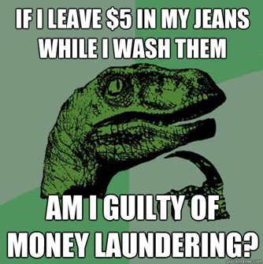
what I will briefly cover in the next section
Contents
Money Laundering and Fraud
Fraud related global regulatory developments
Scams
Fraud typologies
– what is the link?
– a high-level global perspective
– a South African view

Slide 16
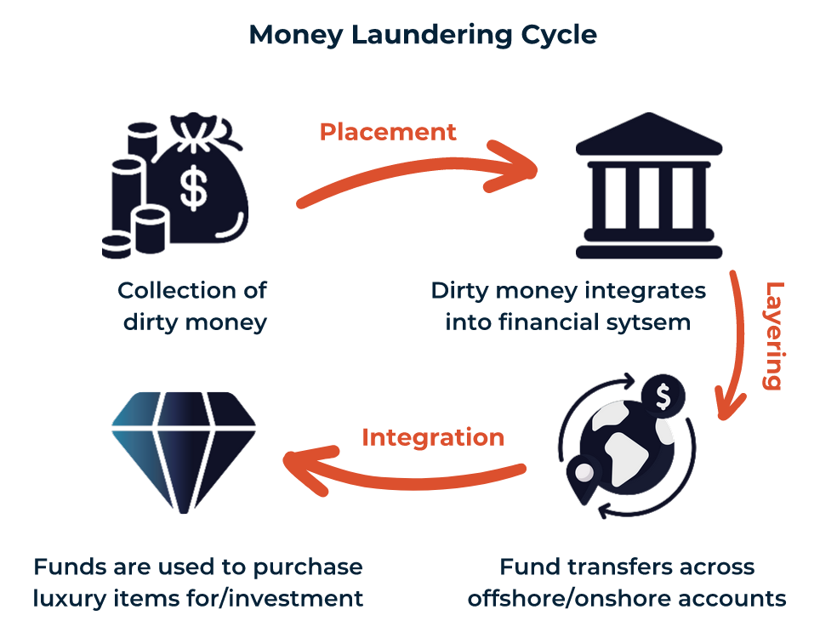
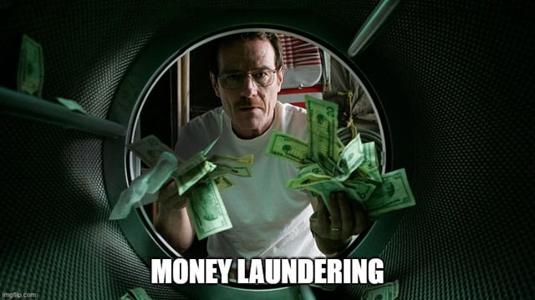
...Back to Basics – what is Money Laundering?
Money laundering involves disguising financial assets / funds so they can be used without detection of the illegal activity that produced them.
Through money laundering, the criminal transforms the proceeds derived from criminal activity into funds with an apparently legal source.

Slide 17
What is a Predicate Offense?
…and why is it important for Money Laundering?
In money laundering, a predicate offense (predicate crime) that generates funds or assets is required as an entry condition. Predicate offences vary in each country and are usually codified in a country's criminal code. Since 2004, the FATF has updated the 40 Recommendations to expand the list of predicate offenses.
Trafficking in human beings and migrant smuggling
Illicit trafficking in stolen and other goods
Forgery
Sexual exploitation
Tax crimes relating to direct and indirect taxes
Environmental crime
e.g.
Kidnapping, illegal restraint, and hostage-taking
Extortion
Participation in an organized criminal group and racketeering
Piracy
Illicit trafficking in narcotic drugs and psychotropic substances
Fraud
Illicit arms trafficking
Cybercrime
Insider trading and market manipulation
Corruption
Counterfeiting of currency
Murder and grievous bodily injury
Robbery or theft
Terrorism
Smuggling
Counterfeiting and pirating of products
Participation in an organized criminal group and racketeering; Terrorism; Trafficking in human beings and migrant smuggling; Sexual exploitation; Illicit trafficking in narcotic drugs and psychotropic substances; Illicit arms trafficking; Illicit trafficking in stolen and other goods; Corruption; Fraud; Counterfeiting of currency; Counterfeiting and pirating of products; Environmental crime; Murder and grievous bodily injury; Kidnapping, illegal restraint, and hostage-taking; Robbery or theft; Smuggling; Tax crimes relating to direct and indirect taxes; Extortion; Forgery; Piracy; Insider trading and market manipulation; Cybercrime

Slide 18
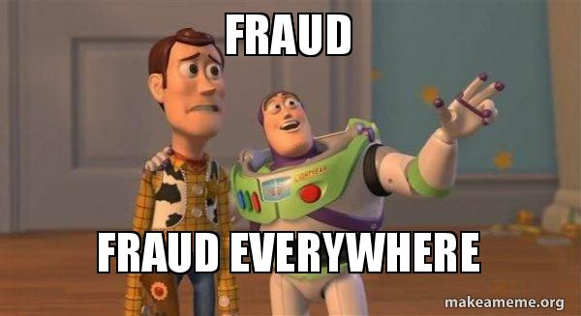

What is Fraud?
An act of intentional deception designed to exploit a victim
OR
The crime of obtaining money or property by deceiving people
Simplified definition of FRAUD (not a legal definition)
Fraud is a predicate offense for Money Laundering!

Slide 19
AML and Fraud… focus now is to bring fraud control firmly in view
Mitigating Risk in the Payments Ecosystem
Traditional Risk Focus Areas
AML
Regulatory Compliance
Counter Financing of Terrorism
Sanctions Compliance
FRAUD Risk
Cybercrime
ESG
Crypto

Slide 20
Fraud related – Global Regulatory developments
Let's start with FATF (Financial Action Task Force) - not a Regulator but a GLOBAL STANDARD SETTING BODY.
FATF Plenary – held 25th –27th Oct 2023
Major amendments to the FATF Recommendations, to provide countries with enhanced tools to more effectively freeze, seize, and confiscate criminal property, both domestically and through international cooperation.
The revised Recommendations require countries to have policies and operational frameworks that prioritise asset recovery and establish non-conviction-based confiscation regimes in their legal systems.
They also provide new features, such as the power to suspend transactions related to money laundering, terrorist financing and serious crime. This will allow relevant national authorities to secure criminal assets more swiftly, increasing the chances of successful confiscation and potential recovery for victims.
This could have significant impact in the payment ecosystem including banks, FI's and Regulators depending on how the member countries interpret and implement!

Slide 21
Fraud related global regulatory developments - UK
ECONOMIC CRIME AND CORPORATE TRANSPARENCY ACT received royal assent 26th October 2023!
The creation of a criminal offence, called ‘failure to prevent fraud’
UK Home Secretary said:
“
It will have a big impact on our ability to fight organised crime, including terrorist funding, fraud and money laundering, and that will ultimately help keep us all safe.
”

Slide 22
Regulatory developments – staying in the UK....
In June 2023, the UK Payment Systems Regulator (PSR) made it mandatory for banks and payment firms to reimburse victims of online bank fraud within five days, in cases where users at a business send money to a bank account controlled by fraudsters.
New rules will be imposed on the Faster Payments system, where the vast majority of APP fraud has occurred so far, with the reimbursement requirements coming into force 2024
Both sending and receiving firms equally splitting the reimbursement costs.
Rules and details – tbd once Parliament expands the powers of the PSR

Slide 23
SCAMS – a high level global perspective
Global Anti Scams Alliance (GASA) 2023 Global state of scams report
Developing countries appear to lose a much higher percentage of GDP in scams
59% of the scam victims perceived a (very) strong emotional impact
25.5%
of global population defrauded as $1.026 trillion is stolen by scammers
"After finding out it was a scam, I almost committed suicide.
Fortunately, my friends were there
for me during those tough times,
and their support made a huge difference."

Slide 24
GASA report continued....
Worst hit by fraudsters, Kenya lost nearly 4.5% of its GDP to scams, followed by Vietnam (3.6%), Brazil & Thailand (3.2%).
Beyond financial loss, the worldwide emotional toll stands significant, with 59% of scam victims reporting a substantial emotional impact, underscoring the global ramifications of scams against general wellbeing, transcending geographical boundaries.
A pattern of revictimization emerges, indicating a global phenomenon of scammers returning to their prey to victimize them again. Most countries experience a revictimization rate of 1.5 per person. At the extreme end of the scale, Kenyans (3) and Nigerians (2) are retargeted the most.
There is a tendency (by 59% of respondents) towards not reporting due to perceived complexity and uncertainty, highlighting a worldwide challenge in scam reporting and resolution.

Slide 25
SOUTH AFRICA – SOUTH AFRICAN FRAUD PREVENTION SERVICE (SAFPS)
FRAUD STATISTICS |  | ECONOMIC STATISTICS
SCAMS INCREASED 150% |  | POVERTY LINE 4.6% INCREASE YEARLY
EMPLOYMENT FRAUD INCREASED 57% |  | UNEMPLOYMENT 31.5%INCREASE YEARLY
IMPERSONATION INCREASED 53% |  | INFLATION 5% INCREASE YEARLY
MONEY MULES INCREASED 44% |  | PEOPLES DESPERATION ???%
37% YOY Growth in number of fraud incidents reported & 15% increase in losses incurred in first 3 quarters of 2023
REPORTED LOSSES
JAN-DEC 2022: > R680M
JAN-AUG 2023: > R1 BILLION
SSAFPS – SOUTH AFRICAN FRAUD PREVENTION SERVICE; SOCIOECONOMIC STATS AS PER STATS SA

Slide 26
Prominent Fraud Typologies – a South African view
Application Fraud | Impersonation Fraud | Scam Fraud
Application fraud takes place at account opening using fake or stolen documents, using the account to withdraw cash, obtain credit, or defraud legitimate entities – MULE ACCOUNT FRAUD is included. | Impersonation Fraud is a type of identity theft where the fraudster leverages stolen information to gain unauthorised access to an account belonging to someone else. Here the payer is not aware of the payment. | Scams are methods of deceitfully obtaining information while looking like they come from trusted sources such as banks or legitimate entities – this is voluntary push payment fraud OR Authorised Push Payment (APP) fraud.
Fake ID Identity Theft First Party Fraud | Remote Account Take Over Phishing Smishing Vishing Sim Swap Identity Theft Stolen Device | Advance Fee scam BEC (Business Email Compromise) Purchase scams Deposit Refund scams Holiday scams Romance scams Investment scams Commodity scams Ancestry scams Loan scams
Source – Southern African Fraud Prevention Service (SAFPS), Bankserve Africa

Slide 27
FRAUD DETECTION IN EKUTA
The project has identified 266 typologies for instant payments (so far)
92 fraud and 174 money-laundering and supporting typologies
31 typologies have been configured in the platform, making use of 33 rules
8 fraud and 23 money-laundering and supporting typologies
Rules focus on fraud and money laundering behaviours
“
Not all money-launderers are fraudsters, but all fraudsters are (eventually) money-launderers.
”
New rules take about two days to develop
Typology composition is a configuration process that can take mere minutes

Slide 28
Fighting Fraud and building trust in the system…
needs a multipronged approach...
A few call outs:
Better technology-based tools and solutions
Meaningful collaboration is key - including public private partnerships (PPP)
DATA SHARING!
Global, regional and local policy requirements relating to fraud need to be enhanced and aligned
Capacity building – develop anti-Fraud skills, resources, training, research and collateral
Consumer empowerment
Fraud utilities like CIFAS in the UK, SAFPS, GASA (and they need to collaborate)
Robust enforcement
Higher prosecution rates
ASSET RECOVERY – make sure crime does NOT pay

Slide 29
PRODUCT UPDATE
EKUTA

Slide 30
EKUTA in COntext
EKUTA is a software engine that provides transaction monitoring-as-a-service
Customers
Financial Service Providers
Transaction Switching Hub
EKUTA Transaction Monitoring
Case Management
(Investigations)
Payment Platform Adapter
Transact. Monitoring Service API
Data Prep.
Transact.
Monitoring Service
Interdiction Alert
FSP via PPA
Case Mgmt.
Evaluation Results
Case Mgmt. Service Publisher
Alert
Rules
FSP Transaction System
Payment Switch
Switch Direct
Results store
Typologies
Evaluation Data
Alert
Data
Storage
Hist.
DB
Additional Supporting Data
PPA
Switch via PPA
Regulator
CMS
Compliance Requests / Data

Slide 31
EKUTA Product Update
What have we done lately?
PLATFORM OPTIMIZATION
Cost per Month (3y reserve) | Annual | Peak FTPS
$1,000 | $12,000 | 45
$5,000 | $60,000 | 407
$10,000 | $120,000 | 1,115
$16,712 | $200,544 | 1,925
Improved throughput to 2000 evaluations per second
7.2m per hour, 63bn per year
Improved evaluation turn-around time to less than 50ms
… AND SOME OTHER STUFF

Slide 32




EKUTA Product Update – PLATFORM OPTIMIZATION HIGHLIGHTS
Removed OpenFaaS
Implemented NATS for end-to-end inter-services pub/sub functionality
Implemented Protocol Buffers for faster inter-service and Redis serialization
Node.js (v8) optimizations
Collapse data transformation into the API
Collapse channel aggregation into the TADProc

Slide 33
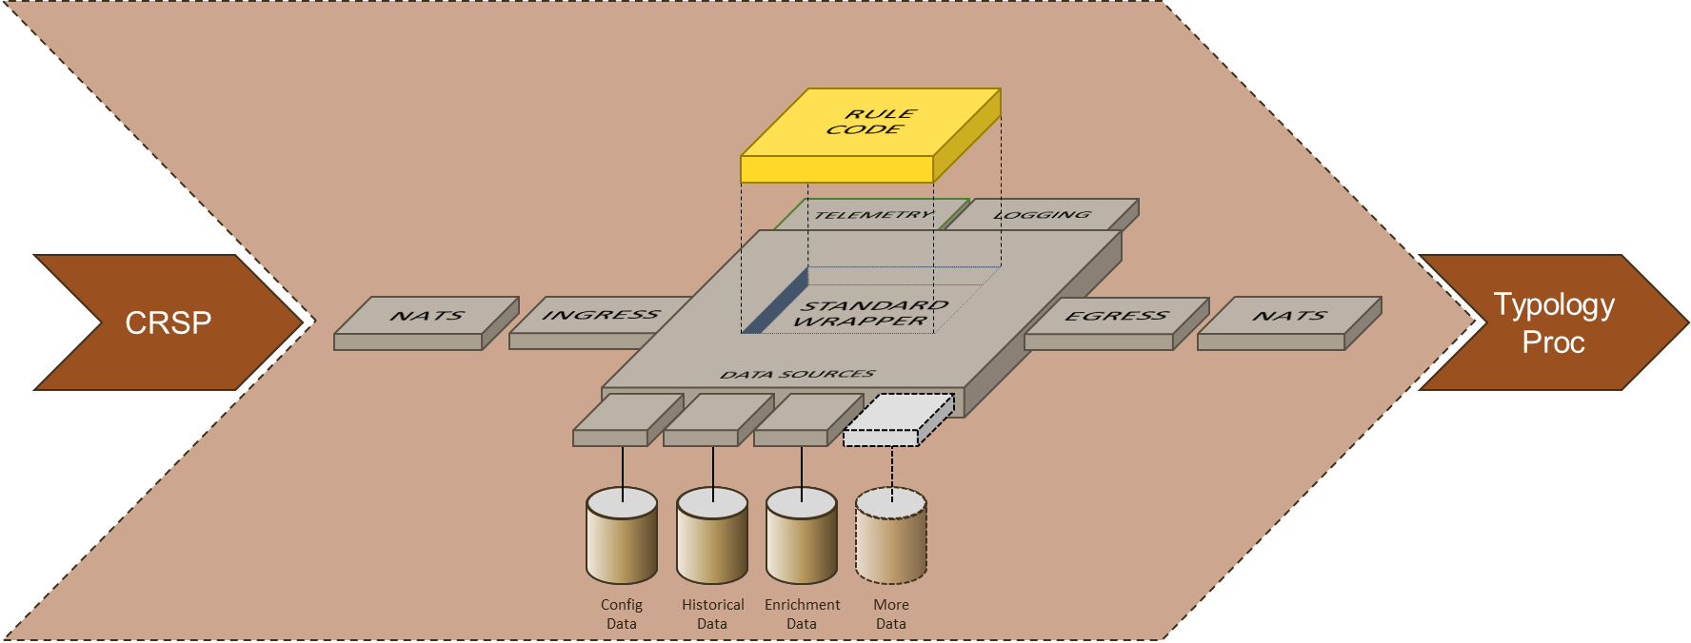
EKUTA Product Update – PLATFORM OPTIMIZATION HIGHLIGHTS
Rule executor
Overhauled the rule processor design
We abstracted and wrapped common rule processor code inside an executor
All rule queries were consolidated and optimized
Previously up to five DB reads; now only one
Forward-casted caching
Connectivity
Config handling
Input subscription
Rule processor
1. Early exit conditions
2. Query setup
3. Query execution
4. Query post-processing
Rule result calculation
Publish rule result
33

Slide 34
EKUTA Product UPDATE – OTHER FEATURES
What else did we do?
Abstracted common code into a centralised code library
Improved rule processor error and exception handling
Two new rules to detect transaction mirroring by the debtor
Rule development turnaround time is now a couple of days
Implemented a containerized Jupyter Notebook
+ standard reporting to support benchmarking
Pin-point transaction ingestion
Implemented a NATS REST proxy for testing via Postman
Composed the platform into a Docker container

Slide 35
EKUTA Product ROADMAP
What are we planning?
Complete optimization at 3000 evaluations per second
Transaction blocking and short-term overrides
Batch processing (data catch-up and evaluations)
Platform Configuration User Interface
Improved and centralized logging and monitoring
Dynamic on-demand scaling
Focus on scaling the infrastructure instead of the software
(starting) Artificial Intelligence and Machine Learning for calibration and rules discovery
Review of ArangoDB’s move to BSL 1.1

Slide 36















EKUTA OPEN-SOURCE TECHNOLOGY STACK
Control & Orchestration
Via Kubernetes Config
Via YAML
Kubernetes API
EKUTA services connected via NATS pub/sub
Scaling
Via Kubernetes
Security
Keycloak
TLS and/or mTLS
Primary orchestration in Kubernetes
API Gateway
EKUTA services
CI/CD
Automated Deployment
Service Testing
REST API
Unit
Testing
Admin & Config
Security
Containerisation
Data-only
processes
Data preparation
Analytics / Telemetry / Logging
External
Data
Sources
Cache
Pseudonymisation
Performance
Result collation
Configs
APM
Entity Resolution
Persistent Data Store
Dashboards
Data transformation
Reports
Data persistence
Config DB
Message history
Evaluation
results
Admin
Rule
Ops
Typology
Historical Graph
Version control/archive

